Slide 1

Group 14
Level 4/5 Group 14: Ethan Ward, Mircea Lazar, Petrut Vasile, Toby White

Slide 2
How the game fits the brief
The game is 2d
The only control is tapping
Each player has a turn
The game will be played on one device
The level design is symmetric
There are two controls which make the game simple and intuitive

Slide 3

Target audience
Core audience
Ages between 11-25
Male
casual gamers

Slide 4

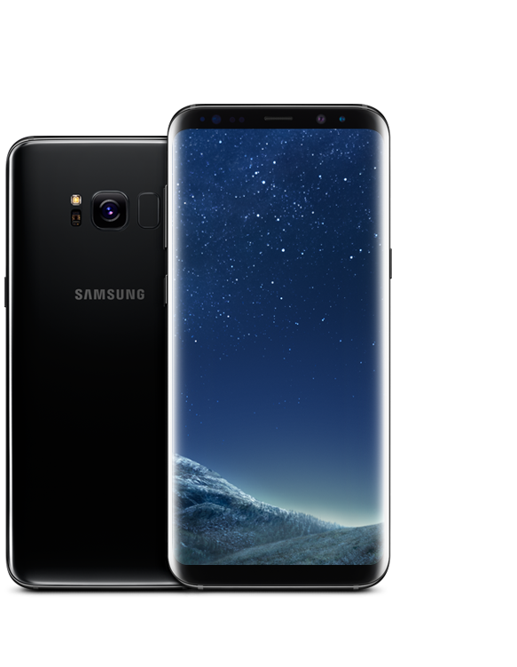


Markets and platform
Platform
Mobile phones
Supported platforms: Android and IOS
Markets
Smartphone markets
Google play store
IOS App store

Slide 5
Games we looked at

Slide 6
What are the games challenges?
Getting the projectile to hit the player which is on the other side of the screen
Timing the shot as the launcher is moving until you tap
Knowing how much power to have to hit the target
Being able to hit the other player when there wind involved

Slide 7
What is the core game loop?
1.
Wait for the shot to be in the right position, tap to set.
5.
When both shots are locked in, projectiles fire at the same time.
2.
Wait for the shot power to be in the right position, tap to set.
4.
Player two repeats player one process
3.
Shot gets locked in, player one turn finished.

Slide 8
What does the player do?
Players will take turns in firing projectiles at each other.
The angle of the launcher will be changing until the player taps, at this point it will lock into place.
The shot power will be changing until the player taps.
When both players have selected their shot angle and power the projectiles will fire.
The end goal will be for one player to get the other persons health to zero.

Slide 9
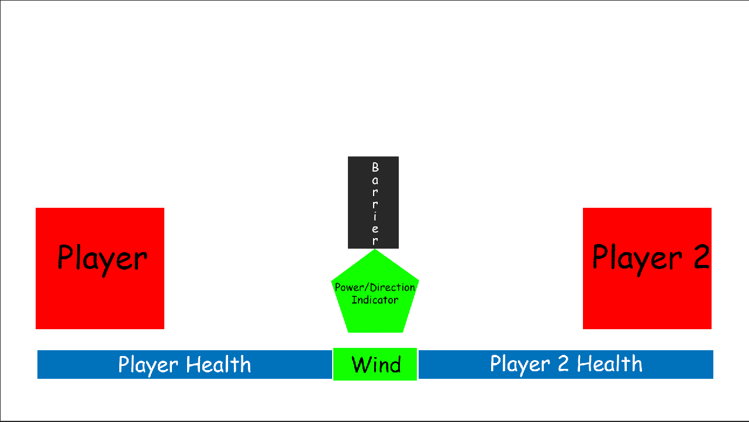
Screen mock-up

Slide 10
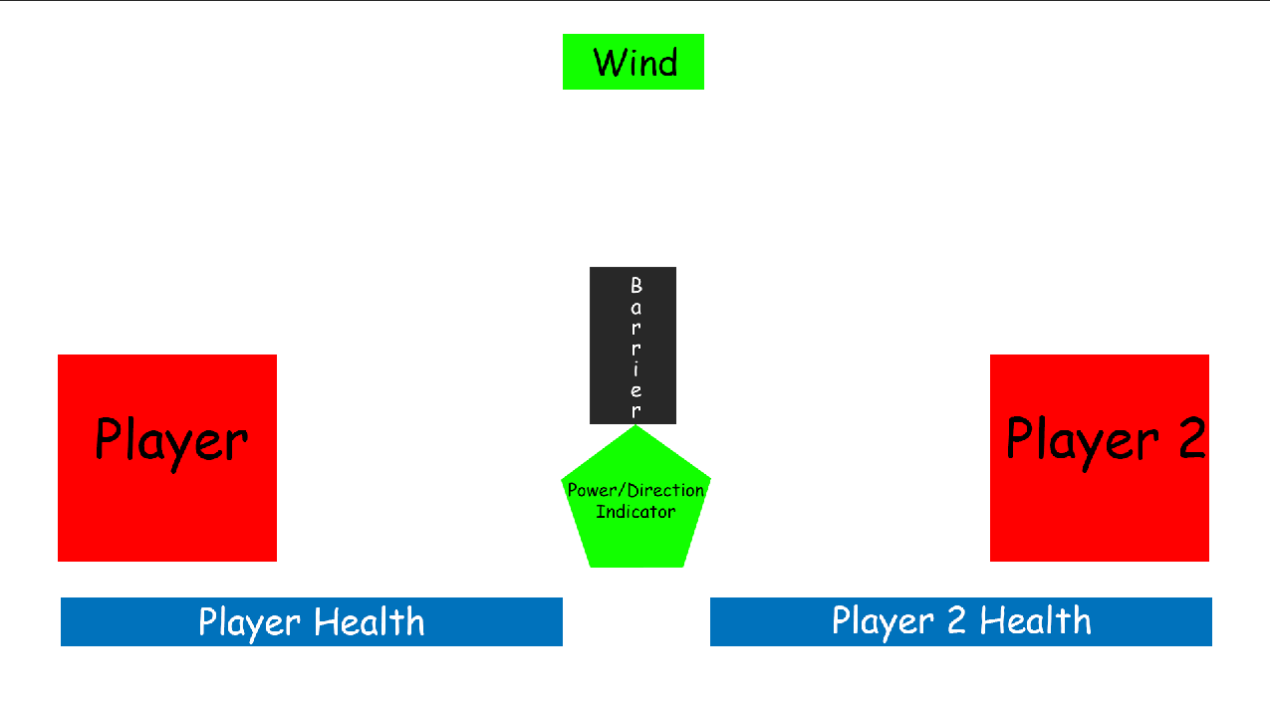
Screen mock-up

Slide 11
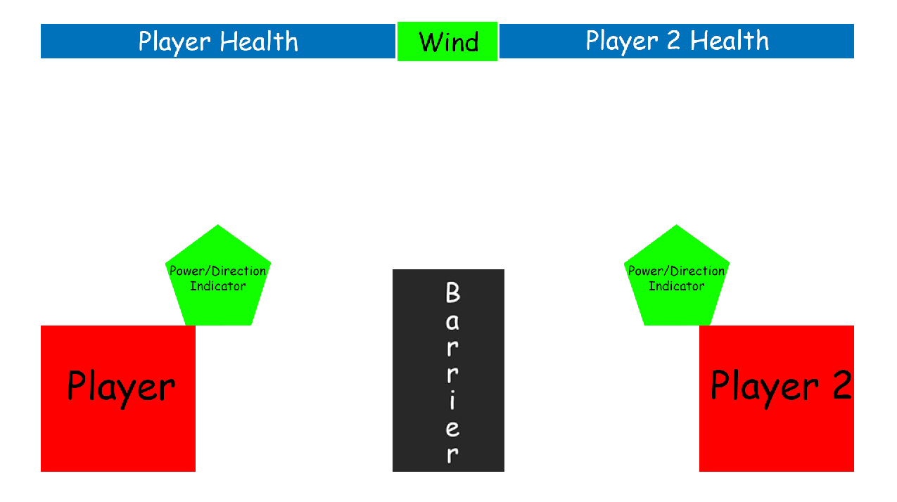
Screen mock-up

Slide 12
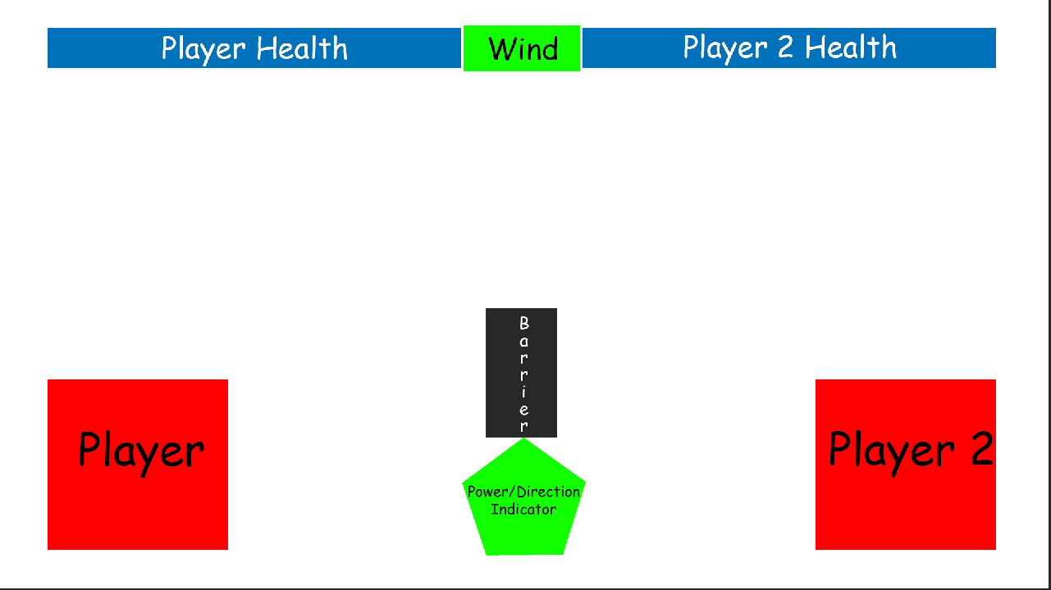
Screen mock-up

Slide 13
First mechanic: shooting/launching
The player will tap to set the position of the launcher
The player will tap again to set the power of the shot
The shot will lock in and then the other player will have their go
When both players have aimed and set the power, both shots will go at the same time.

Slide 14
Second mechanic: Wind
There will be a force (wind) that effects the projectile when it is launched.
This will be the same force for each player
Notes:
On some turns there will be wind that can affect the projectile. to make sure that this is fair for each player, the same force will be applied for both shots.

Slide 15
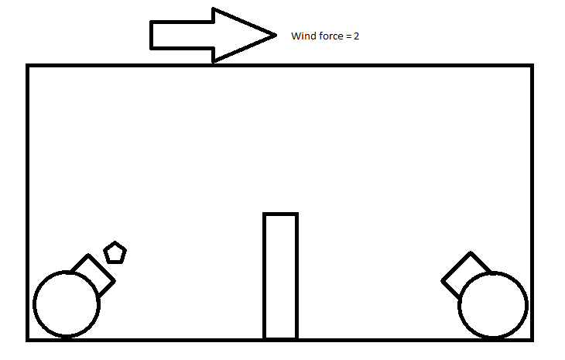
To keep things Symmetrical
Player 1
Player 2
Notes:
The same force will be applied to each of the players turns to keep things symmetrical

Slide 16
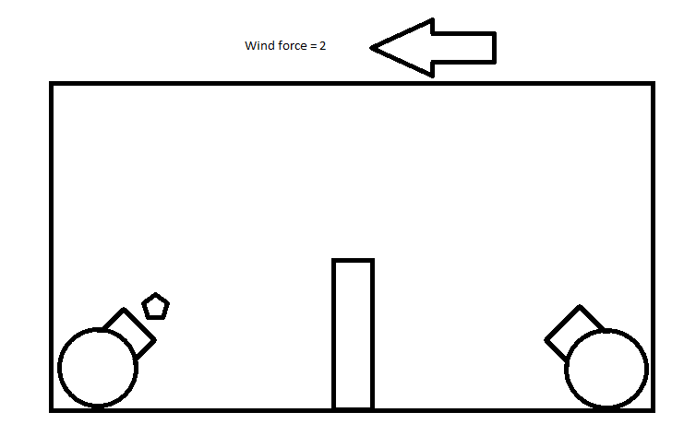
To keep things Symmetrical
Player 1
Player 2
Notes:
The same force will be applied to each of the players turns to keep things symmetrical

Slide 17
The player experience
We want both of the players to experience a sense of hard fun
Fiero, strategy and obstacles
A sense of people fun
Amusement and player interaction

Slide 18
The following week
Picking a theme
Building a prtotype

Slide 19
Any Questions?

